Slide 1
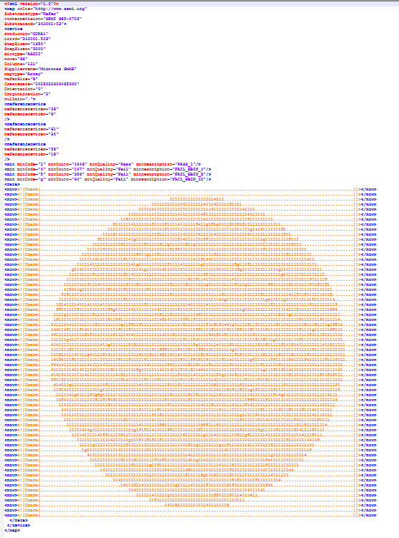
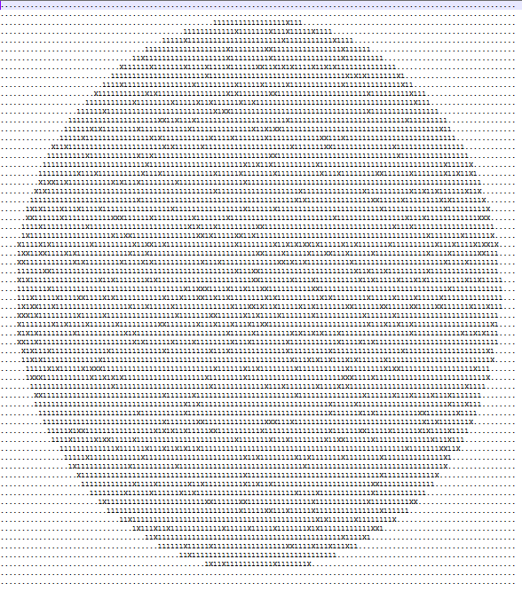
TDK Wafer map file
After Convert
Original Map
Header
Summary good qty
After convert
Yang di convert :
Header, left & right ➔ remove
Bincode selain code 1 ➔ X [NG unit]
Summary report :
Good unit
Wafer ID [ slice name]

Slide 2
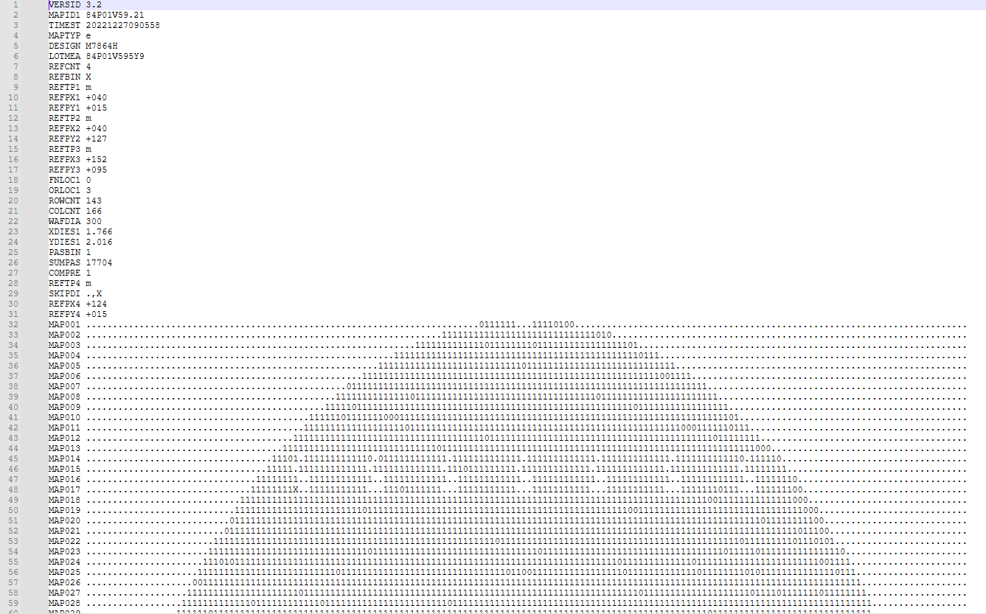


Infineon Wafer map file
Original Map
After Convert
Header
Left index
Yang di convert :
Header, left & right ➔ remove
Left index ➔ Remove
Bin code code 0 ➔ X [NG unit]
Bin code X ➔ + [ reference position]
Summary report :
Good unit
Wafer ID [ slice name]

